Slide 1
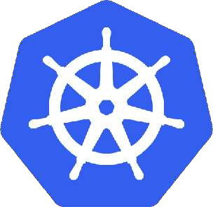
Kubernetes
Agenda
What is Kubernetes?
Advantages of Kubernetes
Kubernetes Architecture
Kubernetes Components
Kubernetes Cluster Setup
Kubernetes Objects
Demo

Slide 2
What is Kubernetes?
Kubernetes is an orchestration engine and open-source platform for managing containerized applications.
Responsibilities include container deployment, scaling & descaling of containers & container load balancing.
Actually, Kubernetes is not a replacement for Docker, But Kubernetes can be considered as a replacement for Docker Swarm, Kubernetes is significantly more complex than Swarm, and requires more work to deploy.
Born in Google ,written in Go/Golang. Donated to CNCF(Cloud native computing foundation) in 2014.
Kubernetes v1.0 was released on July 21, 2015.
Current stable release v1.32

Slide 3
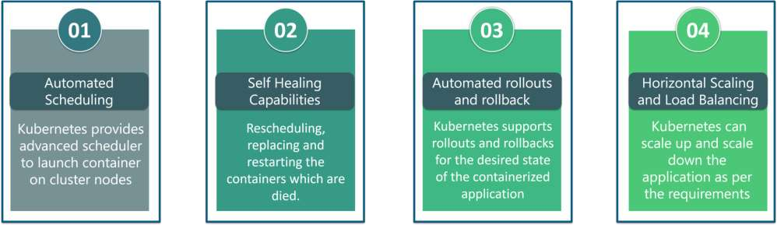
Kubernetes Features
The features of Kubernetes, are as follows:
Automated Scheduling: Kubernetes provides advanced scheduler to launch container on cluster nodes based on their resource
requirements and other constraints, while not sacrificing availability.
Self Healing Capabilities: Kubernetes allows to replaces and reschedules containers when nodes die. It also kills containers that don’t
respond to user-defined health check and doesn’t advertise them to clients until they are ready to serve.
Automated rollouts & rollback: Kubernetes rolls out changes to the application or its configuration while monitoring application health
to ensure it doesn’t kill all your instances at the same time. If something goes wrong, with Kubernetes you can rollback the change.
Horizontal Scaling & Load Balancing: Kubernetes can scale up and scale down the application as per the requirements with a simple
command, using a UI, or automatically based on CPU usage.

Slide 4
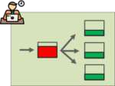
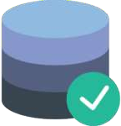
Kubernetes Features
5. Service Discovery & Load balancing
With Kubernetes, there is no need to worry about networking and communication because Kubernetes will automatically assign IP addresses to
containers and a single DNS name for a set of containers, that can load-balance traffic inside the cluster. Containers get their own IP so you can put a set of containers behind a single DNS name for load balancing.
6. Storage Orchestration
With Kubernetes, you can mount the storage system of your choice. You can either opt for local storage, or choose a public cloud provider such as
GCP or AWS, or GCP use a shared network storage system such as NFS, EBS, etc.

Slide 5
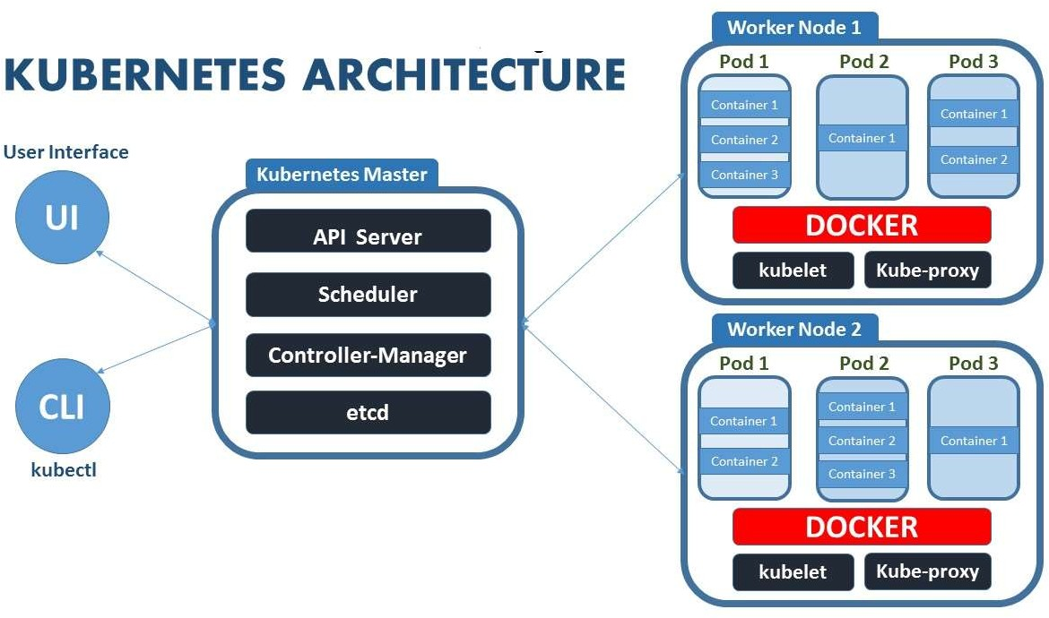
Kubernetes Architecture
Kubernetes implements a cluster computing background, everything works from inside a Kubernetes
Cluster. This cluster is hosted by one node acting as the ‘master’ of the cluster, and other nodes as
‘nodes’ which do the actual ‘containerization‘. Below is a diagram showing the same.

Slide 6
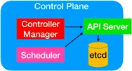
Kubernetes Components
Web UI (Dashboard)
Dashboard is a web-based Kubernetes user interface. You can use Dashboard to deploy containerized applications to a
Kubernetes cluster, troubleshoot your containerized application, and manage the cluster itself along with its available resources.
Kubectl
Kubectl is a command line configuration tool (CLI) for Kubernetes used to interact with master node of kubernetes. Kubectl has a
config file called kubeconfig, this file has the information about server and authentication information to access the API Server.
Master Node
The master node is responsible for the management of Kubernetes cluster. It is mainly the entry point for all administrative tasks. It handles the orchestration of the worker nodes. There can be more than one master node in the cluster to check for fault tolerance.
Master Components
It has below components that take care of communication, scheduling and controllers.
API Server:
Kube API Server interacts with API, Its a frontend of the kubernetes control plane. Communication
center for developers, sysadmin and other Kubernetes components
Scheduler
Scheduler watches the pods and assigns the pods to run on specific hosts.

Slide 7
Kubernetes Components
Controller Manager:
Controller manager runs the controllers in background which runs different tasks in Kubernetes cluster. Performs
cluster-level functions (replication, keeping track of worker nodes, handling nodes failures…).
Some of the controllers are,
Node controller - Its responsible for noticing and responding when nodes go down.
Replication controllers - It maintains the number of pods. It controls how many identical copies of a pod should be running
somewhere on the cluster.
Endpoint controllers joins services and pods together.
Replicaset controllers ensure number of replication of pods running at all time.
Deployment controller provides declarative updates for pods and replicasets.
Daemonsets controller ensure all nodes run a copy of specific pods.
Jobs controller is the supervisor process for pods carrying out batch jobs
etcd
etcd is a simple distribute key value store. kubernetes uses etcd as its database to store all cluster datas. some of the data stored in etcd is job scheduling information, pods, state information and etc.

Slide 8
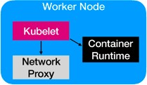
Kubernetes Components
Worker Nodes
Worker nodes are the nodes where the application actually running in kubernetes cluster, it is also know as minion.
These each worker nodes are controlled by the master node using kubelet process.
Container Platform must be running on each worker nodes and it works together with kubelet to run the containers, This is why we use Docker engine
and takes care of managing images and containers.
We can also use other container platforms like CoreOS, Rocket.
Node Components
Kubelet
Kubelet is the primary node agent runs on each nodes and reads the container manifests which ensures that containers are running and healthy.
It makes sure that containers are running in a pod. The kubelet doesn’t manage containers which were not created by Kubernetes.
Kube-proxy
kube-proxy enables the Kubernetes service abstraction by maintaining network rules on the host and performing connection forwarding.
kube-proxy maintains network rules on nodes. These network rules allow network communication to your Pods from inside or outside of your cluster.
It helps us to have network proxy and load balancer for the services in a single worker node..
Service is just a logical concept, the real work is being done by the “kube-proxy” pod that is running on each node.
It redirect requests from Cluster IP(Virtual IP Address) to Pod IP.
Container Runtime
Each node must have a container runtime, such as Docker, rkt, or another container runtime to process instructions from the master server to run
containers.

Slide 9
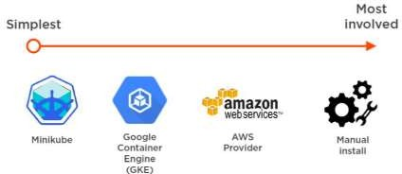
Installation
Different ways to install Kubernetes
Minikube
kubeadm
Google Kubernetes Engine(GKE)
Amazon EKS
Azure Kubernetes Service (AKS)

Slide 10
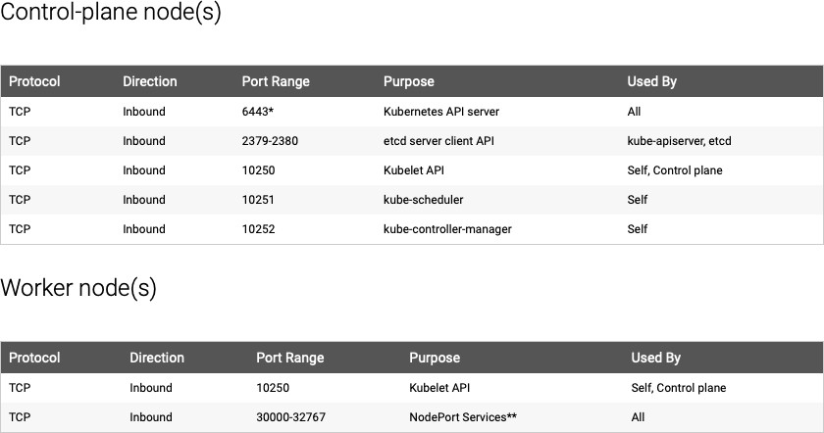
Check required ports

Slide 11
Kubernetes Objects
Kubernetes Objects are persistent entities in the Kubernetes system. Kubernetes uses these entities to represent the state of
your cluster.
A Kubernetes object is a “record of intent”–once you create the object, the Kubernetes system will constantly work to ensure
that object exists.
To work with Kubernetes objects–whether to create, modify, or delete them–you’ll need to use the Kubernetes API. When you
use the kubectl command-line interface, for example, the CLI makes the necessary Kubernetes API calls for you.
The basic Kubernetes objects include:
Pod
Replication Controller
ReplicaSet
DaemonSet
Deployment
Service
ClusterIP
NodePort
Volume
Job

Slide 12
Kubernetes Objects
What is a Namespace?
You can think of a Namespace as a virtual cluster inside your Kubernetes cluster. You can have multiple namespaces inside a single
Kubernetes cluster, and they are all logically isolated from each other. They can help you and your teams with organization, security, and
even performance.
The first three namespaces created in a cluster are always default, kube-system, and kube-public. While you can technically deploy within these namespaces, I recommend leaving these for system configuration and not for your projects.
Default is for deployments that are not given a namespace, which is a quick way to create a mess that will be hard to clean up if you do too many deployments without the proper information.
Kube-system is for all things relating to the Kubernetes system. Any deployments to this namespace are playing a dangerous game and can accidentally cause irreparable damage to the system itself.
Kube-public is readable by everyone, but the namespace is reserved for system usage.
Using namespaces for isolation
I have used namespaces for isolation in a couple of ways. I use them most often to split many users' projects into separate environments. This is useful in preventing cross-project contamination since namespaces provide independent environments.
kubectl get namespace
kubectl create namespace test
https://cloud.google.com/blog/products/gcp/kubernetes-best-practices-organizing-with-namespaces

Slide 13
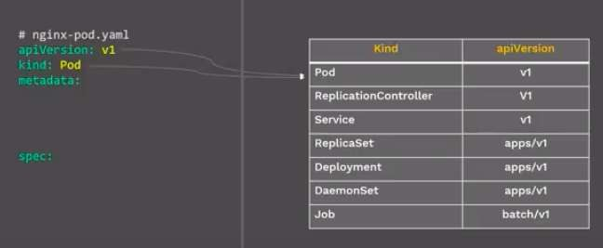
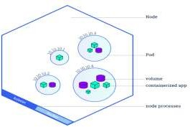
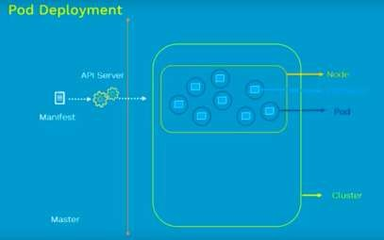
Kubernetes Objects
POD
A Pod always runs on a Node.
A pod is the smallest building block or basic unit of scheduling in Kubernetes.
In a Kubernetes cluster, a pod represents a running process.
Inside a pod, you can have one or more containers. Those containers all share a unique network IP, storage, network and any
other specification applied to the pod.
apiVersion: v1
POD is a group of one or more containers which will be running on some node.
Each Pod has its unique IP Address within the cluster.
kind: Pod metadata:
name: nginx-pod
labels:
app: nginx spec: containers:
- name: first-container image: nginx
ports:
- containerPort: 80
Command
kubectl apply –f pod.yml

Slide 14
Kubernetes Objects
Pod Lifecycle
Make a Pod reuqest to API server using a local pod defination file
The API server saves the info for the pod in ETCD
The scheduler finds the unscheduled pod and shedules it to node.
Kubelet running on the node, sees the pod sheduled and fires up container-runtime.
The entire lifecycle state of the pod is stored in ETCD.
Pod Concepts
Pod is ephemeral(lasting for a very short time) and won’t be rescheduled to a new node once it dies.
You should not directly create/use Pod for deployment, Kubernetes have controllers like Replica Sets, Deployment, Deamon sets to keep pod alive.

Slide 15
Pod model types
Most often, when you deploy a pod to a Kubernetes cluster, it'll contain a single container. But there are instances when you might need to deploy a pod with multiple containers.
There are two model types of pod you
can create:
One-container-per-pod. This model is the most popular. POD is the “wrapper” for a single container. Since pod is the smallest object that K8S recognizes, it manages the pods instead of directly managing the containers.
Multi-container-pod or Sidecar containers In this model, a pod can hold multiple co-located containers primary container And utility container that helps or enhances how an application functions (examples of sidecar containers are log shippers/watchers and monitoring agents).

Slide 16
Static Pods
Static Pods are managed directly by the kubelet and the API server does not have any control over these pods. The kubelet is responsible to watch each static Pod and
restart it if it crashes. The static Pods running on a node are visible on the API server but cannot be controlled by the API Server. Static Pod does not have any associated
replication controller, kubelet service itself watches it and restarts it when it crashes. There is no health check for static pods.
The main use for static Pods is to run a self-hosted control plane: in other words, using the kubelet to supervise the individual control plane components.
Static Pods are always bound to one Kubelet on a specific node.
Kubernetes Labels and Selectors
Labels
When One thing in k8s needs to find another things in k8s, it uses labels. Labels are key/value pairs attached to Object
You can make your own and apply it.
it’s like tag things in kubernetes For e.g.
labels:
app: nginx role: web env: dev
Selectors
Selectors use the label key to find a collection of objects matched with same value
It’s like Filter, Conditions and query to your labels
For e.g. selectors:
env = dev
app != db
release in (1.3,1.4)
Labels and Selectors are used in many places like Services, Deployment and we will see now in Replicasets.

Slide 17
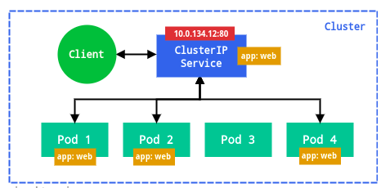
Kubernetes Objects
Service
A service is responsible for making our Pods discoverable inside the network or exposing them to the internet. A Service identifies Pods by its LabelSelector.
Types of services available:
ClusterIP – Exposes the service on a cluster-internal IP. Service is only reachable from within the cluster. This is the default Type.
When we create a service we will get one Virtual IP (Cluster IP) it will get registered to the DNS(kube-dns). Using this Other
PODS can find and talk the pods of this service using service name.
Service is just a logical concept, the real work is being done by the “kube-proxy” pod that is running on each node.
It redirect requests from Cluster IP(Virtual IP Address) to Pod IP.
# Service Cluster IP apiVersion: v1 kind: Service metadata:
name: nginxsvc spec:
selector: app: nginx
type: ClusterIP
ports:
- name: http
port: 80
targetPort: 80 protocol: TCP
APP 2 POD

Slide 18
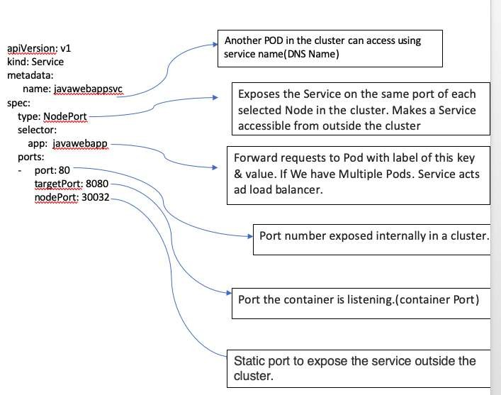
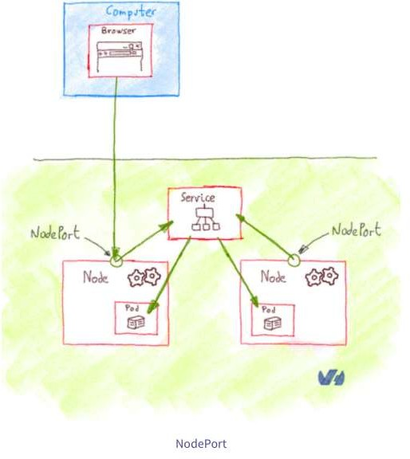
Kubernetes Objects
NodePort – Exposes the service on each Node’s IP at a static port. A ClusterIP service, to which the NodePort service will route, is automatically created. You’ll be able to contact the NodePort service, from outside the cluster, by using “<NodeIP>:<NodePort>”.
apiVersion: v1 kind: Service metadata:
name: javawebappsvc spec:
selector:
app: javawebapp type: NodePort ports:
- port: 80
targetPort: 8080
nodePort: 30032
Note: If we don’t define nodePort value for NodePort Service. K8’s will randomly
Allocate a nodePort with in 30000—32767.

Slide 19
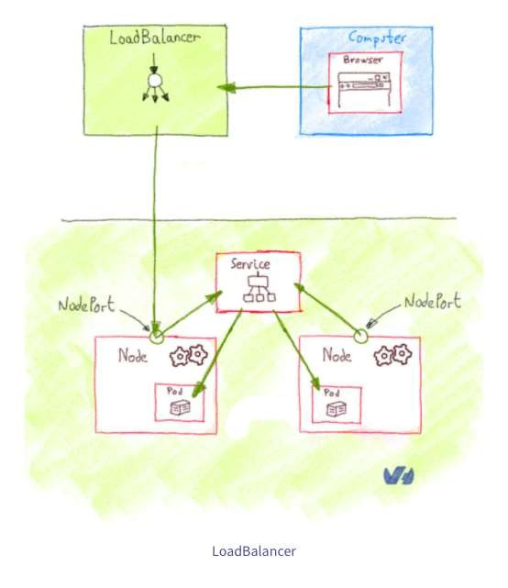
Kubernetes Objects
LoadBalancer – Exposes the service externally using a cloud provider’s load balancer. NodePort and ClusterIP services, to
which the external load balancer will route, are automatically created.
If you are using a custom Kubernetes Cluster
(using minikube, kubeadm or the like). In this case, there is no LoadBalancer integrated (unlike AWS EKS or Google Cloud,KOPS,AKS). With this default setup, you can only
use NodePort.
Configure Load Balancer Externally.
apiVersion: v1
kind: Service
metadata:
name: javawebappsvc
spec:
ports:
- port: 80
targetPort: 8080
selector:
app: javawebapp
type: LoadBalancer

Slide 20
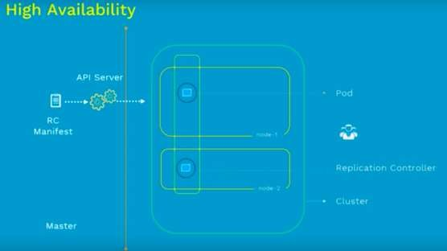
Replication Controller
Replication Controller is one of the key features of Kubernetes, which is responsible for managing the pod lifecycle. It is
responsible for making sure that the specified number of pod replicas are running at any point of time.
A Replication Controller is a structure that enables you to easily create multiple pods, then make sure that that number of
pods always exists. If a pod does crash, the Replication Controller replaces it.
Replication Controllers and PODS are associated with labels.
Creating “RC” with count of 1 ensure that a POD is always available.
apiVersion: v1
kind: ReplicationController
metadata:
name: nginx-rc
spec:
replicas: 2 selector:
app: nginx template: metadata:
name: nginx
labels:
app: nginx spec: containers:
- name: nginx image: nginx ports:
- containerPort: 80
Command
kubectl apply –f rc.yml

Slide 21
ReplicaSet
apiVersion: apps/v1 kind: ReplicaSet metadata:
name: nginx-replicaset spec:
replicas: 2 selector: matchLabels:
app: nginx-rs-pod
matchExpressions:
key: env operator: In values:
dev template: metadata:
labels:
app: nginx-rs-pod
env: dev spec: containers:
name: nginx image: nginx ports:
- containerPort: 80
ReplicaSet is the next-generation Replication
Controller.
The only difference between a ReplicaSet and
a Replication Controller right now is the selector
support.
ReplicaSet supports the new set-based selector requirements as described in the labels user guide whereas a Replication Controller only supports equality-based selector requirements.
kubectl apply –f rs.yml
kubectl scale rs nginx-replicaset --replicas 3

Slide 22
DaemonSet
A DaemonSet make sure that all or some kubernetes Nodes run a copy of a Pod.
When a new node is added to the cluster, a Pod is added to it to match the rest of the nodes and when a node is removed from
the cluster, the Pod is garbage collected.
Deleting a DaemonSet will clean up the Pods it created.
# Daemon Set apiVersion: apps/v1 kind: DaemonSet metadata:
name: nginx-ds
spec:
selector: matchLabels:
app: nginx-pod
template:
metadata:
name: nginx-pod
labels:
app: nginx-pod spec: nodeSelector:
name: node1 containers:
- name: webserver image: nginx ports:
- containerPort: 80
Command
kubectl apply –f daemonset.yml

Slide 23
Kubernetes Objects
Deployment
In Kubernetes, Deployment is the recommended way to deploy Pod or RS, simply because of
the advance features it comes with.
Below are some of the key benefits.
apiVersion: apps/v1 kind: Deployment metadata:
name: nginx
spec:
replicas: 3
strategy:
type: ReCreate selector: matchLabels:
app: nginx template: metadata:
labels:
app: nginx spec: containers:
- name: nginx image: nginx:1.7.9 ports:
- containerPort: 80
Deploy a RS.
Updates pods (PodTemplateSpec).
Rollback to older Deployment versions.
Scale Deployment up or down.
Pause and resume the Deployment.
Use the status of the Deployment to determine state of replicas.
Clean up older RS that you don’t need anymore.
kubectl scale deployment [DEPLOYMENT_NAME] --replicas [NUMBER_OF_REPLICAS]
kubectl rollout status deployment nginx-deployment
kubectl get deployment
kubectl set image deployment nginx-deployment nginx-container=nginx:latest --record
kubectl get replicaset
kubectl rollout history deployment nginx-deployment
kubectl rollout history deployment nginx-deployment --revision=1
kubectl rollout undo deployment nginx-deployment --to-revision=1

Slide 24
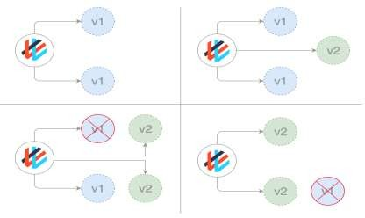
Kubernetes Objects
# Deployments Rolling
Update
apiVersion: apps/v1 kind: Deployment metadata:
name: nginx-deployment
spec:
replicas: 2 strategy:
type: RollingUpdate
rollingUpdate: maxSurge: 1
maxUnavailable: 1
minReadySeconds: 30 selector: matchLabels:
app: nginx template: metadata:
name: nginx-pod labels:
app: nginx spec: containers:
- name: nginx-container image: nginx:1.7.9 ports:
- containerPort: 80
Deployment Strategies
There are several different types of deployment strategies you can take advantage of depending on your
goal.
Rolling Deployment
The rolling deployment is the standard default deployment to Kubernetes. It works by slowly, one by one, replacing pods of the previous version of your application with pods of the new version without any cluster downtime.
A rolling update waits for new pods to become ready before it starts scaling down the old ones. If there is a problem, the rolling update or deployment can be aborted without bringing the whole cluster down. In the YAML definition file for this type of deployment, a new image replaces the old image.

Slide 25
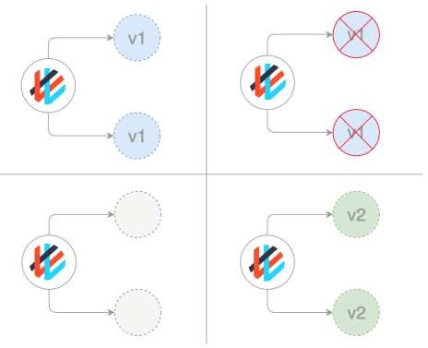
Kubernetes Objects
apiVersion: apps/v1 kind: Deployment metadata:
name: nginx spec:
replicas: 3
strategy:
type: Recreate selector: matchLabels:
app: nginx template: metadata:
labels:
app: nginx spec: containers:
- name: nginx image: nginx:1.7.9 ports:
- containerPort: 80
Deployment Strategies Recreate
In this type of very simple deployment, all of the old pods are killed all at once and
get replaced all at once with the new ones.

Slide 26
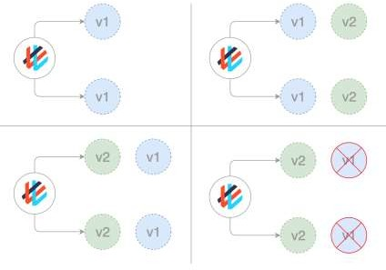
Kubernetes Objects
Deployment Strategies
Blue/ Green (or Red / Black) deployments
In a blue/green deployment strategy (sometimes referred to as red/black) the old version of the application (green) and the new version (blue) get deployed at the same time. When both of these are deployed, users only have access to the green; whereas, the blue is available to your QA team for test automation on a separate service or via direct port- forwarding.
After the new version has been tested and is signed off for release, the service is switched to the blue version with the
old green version being scaled down:
apiVersion: v1 kind: Service metadata:
name: awesomeapp
spec:
selector:
app: awesomeapp
version: "02"

Slide 27
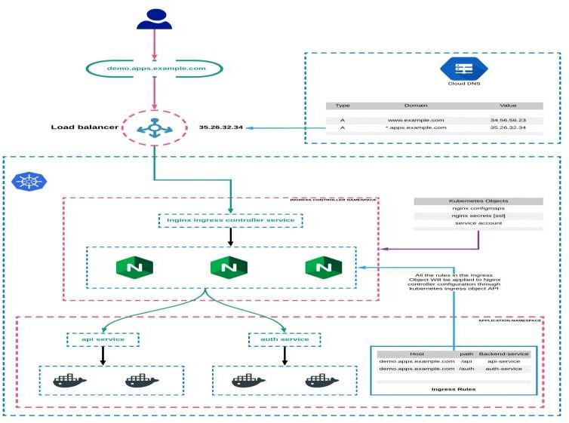
Kubernetes Objects
Ingress – Kubernetes Ingress is a resource to add rules for routing traffic from external sources to the services in the
kubernetes cluster.
Kubernetes Ingress:
Kubernetes Ingress is a native kubernetes resource where you can have rules to route traffic from an external source to service endpoints residing inside the cluster. It requires an ingress controller for routing the rules specified in the ingress object.
Kubernetes Ingress Controller
Ingress controller is typically a proxy service deployed in the cluster. It is nothing but a kubernetes deployment exposed to a service. Following are the ingress controllers available for kubernetes.
Following are the ingress controllers available for kubernetes. Nginx Ingress Controller (Community & From Nginx Inc) Traefik
HAproxy Contour
GKE Ingress Controller

Slide 28
Kubernetes Volumes
# Mongo host path rc apiVersion: v1
kind: ReplicationController
metadata:
labels:
name: mongo
name: mongo-controller
spec:
replicas: 1 template:
metadata:
labels:
name: mongo
spec:
containers:
image: mongo name: mongo ports:
name: mongo containerPort: 27017
hostPort: 27017 volumeMounts:
name: mongo-persistent-storage mountPath: /data/db
volumes:
name: mongo-persistent-storage hostPath:
path: /tmp/dbbackup
A Container's file system lives only as long as the Container does. So when a Container terminates and restarts, filesystem changes are lost. Volumes in Kubernetes are very easy to manage. It is basically a directory that gets mounted to a pod. After telling the container to use Volumes for storing evergreen information, you can safely modify the pods without ever losing your data.
Kubernetes supports many types of volumes, and a Pod can use any number of them simultaneously. For more consistent storage that is independent of the Container, we can use a Volume. This is especially important for stateful applications, such as databases.
To use a volume, a Pod specifies what volumes to provide for the Pod (the .spec.volumes field) and where to mount those into Containers (the .spec.containers.volumeMounts field) as shown.
Kubernetes supports several types of Volumes:
awsElasticBlockStore azureDisk
azureFile configMap emptyDir gcePersistentDisk
gitRepo (deprecated) hostPath
nfs persistentVolumeClaim secret

Slide 29
Kubernetes Volumes
Persistent Volumes
Persistent Volumes are simply a piece of storage in your cluster. Similar to how you have a disk resource in a server, a persistent volume provides storage resources for objects in the cluster. At the most simple terms you can think of a PV as a disk drive. It should be noted that this storage resource exists independently from any pods that may consume it. Meaning, that if the pod dies, the storage should remain intact assuming the claim policies are correct. Persistent Volumes are provisioned in two ways, Statically or Dynamically.
Static Volumes – A static PV simply means that some k8s administrator provisioned a persistent volume in the cluster and it’s ready to be
consumed by other resources.
Dynamic Volumes – In some circumstances a pod could require a persistent volume that doesn’t exist. In those cases it is possible to have k8s provision the volume as needed if storage classes were configured to demonstrate where the dynamic PVs should be built. This post will focus on static volumes for now.
Persistent Volume Claims
Pods that need access to persistent storage, obtain that access through the use of a Persistent Volume Claim. A PVC, binds a persistent volume to
a pod that requested it.
When a pod wants access to a persistent disk, it will request access to the claim which will specify the size , access mode and/or storage classes that it will need from a Persistent Volume. Indirectly the pods get access to the PV, but only through the use of a PVC.
Claim Policies
We also reference claim policies earlier. A Persistent Volume can have several different claim policies associated with it including:
Retain – When the PVC is deleted, the PV still exists and the volume is considered "released". But it is not yet available for another claim because the previous claimant's data remains on the volume. An administrator we can manually reclaim the volume.
Recycle – When the claim is deleted the volume remains but performs a basic scrub(delete data from storage) (rm -rf /volume/*) on the volume and makes it available again for a new claim.
Delete – When the claim is deleted, it removes both the Persistent Volume object from Kubernetes, as well as the associated storage.
The claim policy (associated at the PV and not the PVC) is responsible for what happens to the data on when the claim has been deleted.

Slide 30
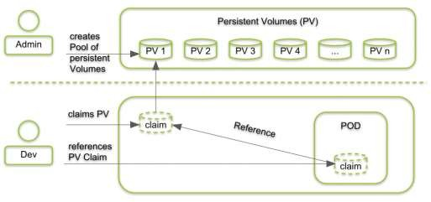
Kubernetes Volumes
ConfigMaps and Secrets
Application’s configuration can change between environments (e.g. development, staging, production, etc.) and that you want your applications to be portable. It is a good practice to make container images as reusable as possible. The same image should be able to be used for development, staging, and production.
Thus, you should store the config(like db connection details, passwords, API Keys ..etc) outside of the application itself.
We externalize things that can change and this in turn helps keep our applications portable. This is critical in the Kubernetes
world where our applications are packaged as Docker images.
With Docker and containers this means we should try to keep configuration out of the container image. Developer should not
hard code configuration details instead they can refer/use Environment Variables.
Docker makes it easy to build containers with environment variables baked in. In your Dockerfile, you can specify them with the ENV directive.You can also override the environment variables when running on the command line.

Slide 31
ConfigMaps and Secrets
An app’s config is everything that is likely to vary between deploys (staging, production, developer environments, etc). This includes database connections details and
credentials or cloud credentials ..etc.
Kubernetes allows you to provide configuration information to our applications through ConfigMaps or secret resources. The main differentiator between the two is
the way a pod stores the receiving information and how the data is stored in the etcd data store.
Both, ConfigMaps and Secrets store data as a key value pair. The major difference is, Secrets store data in base64 format meanwhile ConfigMaps store data in a plain
text.
If you have some critical data like, keys, passwords, service accounts credentials, db connection string, etc then you should always go for Secrets rather than Configs.
And if you want to do some application configuration using environment variables which you don't want to keep secret/hidden like, app base platform url, etc then you can go for ConfigMaps.
Sample Manifest Links: https://github.com/MithunTechnologiesDevOps/Kubernates-Manifests/blob/master/mysql- deployment-configmap.yml
https://github.com/MithunTechnologiesDevOps/Kubernates-Manifests/blob/master/mysql-deployment-configSecret.yml
Secret:
docker-registry
This is used by the kubelet when passed in a pod template if there is an imagePullsecret to provide the credentials needed to authenticate to a private Docker registry:
kubectl create secret docker-registry registryKey --docker-server <PrivateRepoURL> --docker-username <userName> --docker-
password <password> --docker-email <email>
https://opensource.com/article/19/6/introduction-kubernetes-secrets-and-configmaps https://medium.com/google-cloud/kubernetes-configmaps-and-secrets-68d061f7ab5b https://www.oreilly.com/library/view/kubernetes-best-practices/9781492056461/ch04.html

Slide 32
Liveness And Readiness Probes
Liveness and Readiness probes are used to control the health of an application running inside a Pod’s container.
Liveness Probe
Suppose that a Pod is running our application inside a container, but due to some reason let’s say memory leak, cpu usage, application deadlock etc the
application is not responding to our requests, and stuck in error state.
Liveness probe checks the container health as we tell it do, and if for some reason the liveness probe fails, it restarts the container.
Readiness Probe
This type of probe is used to detect if a container is ready to accept traffic. You can use this probe to manage which pods are used as
backends for load balancing services. If a pod is not ready, it can then be removed from the list of load balancers.
Manifest File Link:
https://github.com/MithunTechnologiesDevOps/Kubernates-Manifests/blob/master/liveness_readiness_probes_example.yml
https://docs.okd.io/latest/dev_guide/application_health.html
https://medium.com/spire-labs/utilizing-kubernetes-liveness-and-readiness-probes-to-automatically-recover-from-failure-2fe0314f2b2e https://www.weave.works/blog/resilient-apps-with-liveness-and-readiness-probes-in-kubernetes

Slide 33
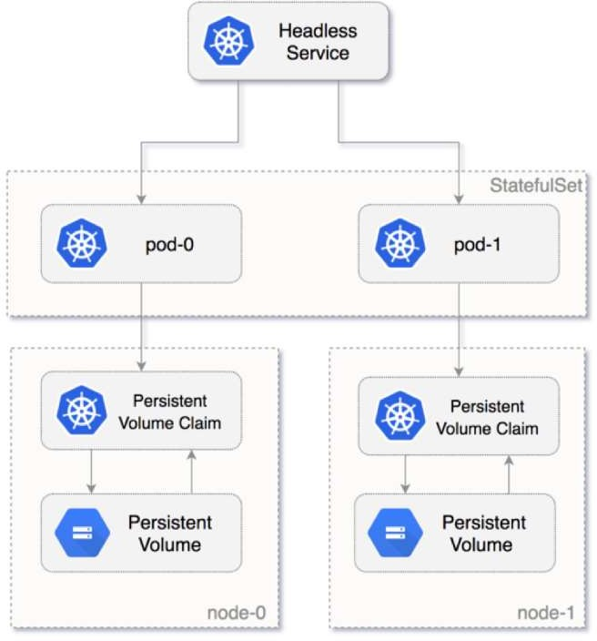
Stateful Sets
Deployments are usually used for stateless applications. However, you can save the state of deployment by attaching a Persistent Volume to it and make it stateful, but all the pods of a deployment will be sharing the same Volume and data across all of them will be same.
SatefulSet is a Kubernetes resource used to manage stateful applications. It manages the deployment and scaling of a set of Pods, and provides guarantee about the ordering and uniqueness of these Pods.
StatefulSet is also a Controller but unlike Deployments, it doesn’t create
ReplicaSet rather itself creates the Pod with a unique naming convention.
e.g. If you create a StatefulSet with name mongo, it will create a pod with name mongo-0, and for multiple replicas of a statefulset, their names will increment like mongo-0, mongo-1, mongo-2, etc
Every replica of a stateful set will have its own state, and each of the pods will be creating its own PVC(Persistent Volume Claim). So a statefulset with 3 replicas will create 3 pods, each having its own Volume, so total 3 PVCs.
By far the most common way to run a database, StatefulSets is a feature fully supported as of the Kubernetes 1.9 release. Using it, each of your pods is guaranteed the same network identity and disk across restarts, even if it's rescheduled to a different physical machine.

Slide 34
Stateful Sets
StatefulSet Deployments provide:
Stable, unique network identifiers: Each pod in a StatefulSet is given a hostname that is based on the application name and increment. For example, mongo-1, mongo-2 and mongo-3 for a StatefulSet named “mongo” that has 3 instances running.
Stable, persistent storage: Each and every pod in the cluster is given its own persistent volume based on the storage class defined, or the default, if none are defined. Deleting or scaling down pods will not automatically delete the volumes associated with them- so that the data persists. you could scale the StatefulSet down to 0 first, prior to deletion of the unused pods.
Ordered, graceful deployment and scaling: Pods for the StatefulSet are created and brought online in order, from 1 to n, and they are shut down in reverse order to ensure a reliable and repeatable deployment and runtime. The StatefulSet will not even scale until all the required pods are running, so if one dies, it recreates the pod before attempting to add additional instances to meet the scaling criteria.
Ordered, automated rolling updates: StatefulSets have the ability to handle upgrades in a rolling manner where it shuts down and rebuilds each node in the order it was created originally, continuing this until all the old versions have been shut down and cleaned up. Persistent volumes are reused, and data is automatically migrated to the upgraded version.

Slide 35
Questions ?

